Slide 1
Safeguarding Refresher Training: September 2022
Some of the content covered in today’s session may affect you on a personal level.
Please take a break if you need to or speak to your manager/member of the safeguarding team if you want to discuss anything following the training.

Slide 2
Warm Up: Safeguarding loves an acronym – how many do you know?
MASH |  | CSE |  | CAMHS/AMHS
SCR |  | FGM |  | MEHT
CCE |  | DSL |  | VAWG
YOT |  | CiN |  | DA
KCSIE |  | PEP |  | YPSI
LAC |  | CME |  | IAPT
ESOL |  | EHCP |  | LADO

Slide 3
How many did you get right?
MASH ​ ​ ​ | Multi – Agency Safeguarding Hub​ | CSE ​ | Child Sexual Exploitation​ | CAMHS/AMHS​ | Child and Adolescent Mental Health Services/Adult ​
SCR ​ ​ ​ | Single Central Record​ ​ | FGM ​ | Female Genital Mutilation​ | MEHT​ | Mental and Emotional Health Team ​
CCE​ | Child Criminal Exploitation​ | DSL ​ ​ | Designated Safeguarding Lead​ | VAWG​ | Violence Against Women and Girls ​
YOT​ | Youth Offending Team​ | CiN ​ ​ ​ | Child in Need​ | DA​ | Domestic Abuse ​
KCSIE​ | Keeping Children Safe in Education ​ | PEP​ ​ ​ | Personal Education Plan​ | YPSI​ | Youth Produced Sexual Imagery ​
LAC​ | Looked After Child ​ | CME​ | Child Missing in Education ​ | IAPT​ | Improving Access to Psychological Therapies​
ESOL​ | English for Speakers of Other Languages ​ | EHCP​ | Educational Health Care Plan ​ | LADO​ | Local Authority Designated Officer​

Slide 4
What is Safeguarding:
Protecting children* from maltreatment
Preventing the impairment of children’s mental and physical health or development
Ensuring that children grow up in circumstances consistent with the provision of safe and effective care
Taking action to enable all children to have the best outcomes
(KCSIE September 2022)
*Child is defined as up to 18th Birthday.

Slide 5
Why is Safeguarding so important…..
Now an increased emphasis in education and working in partnership with other agencies
We have a statutory responsibility to look after the students in our care
There is a potential impact on educational outcomes.
There is a reputational impact if things go wrong

Slide 6
Who are we safeguarding?
Children = under 18 years of age (including unborn children)
Vulnerable Groups:
Specific additional needs and/or EHCP
Looked After Child / Young care leaver
Young carer
ESOL
Adults at Risk / Vulnerable Adults
An adult ‘at risk’ is a person “Who is or may be in need of community care services by reason of disability, age or illness; and is or may be unable to take care of or unable to protect him or herself against significant harm or exploitation”.

Slide 7
Keeping Children Safe in Education (KCSIE) September 2022
All staff must read Part A and must confirm they have read it.
Key changes in Part A for September 2022:
Peer on Peer Abuse renamed Child on Child Abuse
Children must have an appropriate adult present during police investigations
Online checks for new staff
More emphasis on domestic abuse and effects on children in household
More focus on preventative education
Human Rights and Equality Act is highlighted in ensuring safeguarding practices meet legislation
More details about the implementation of Low Level Concerns

Slide 8
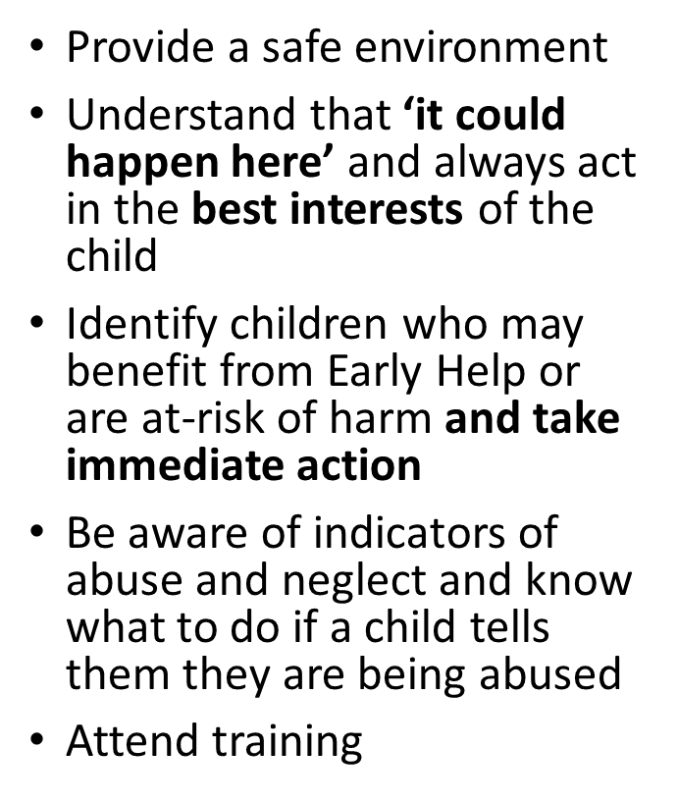
Keeping Children Safe in Education (KCSIE) September 2022: All Staff must…..
Be aware of School systems to support safeguarding
Understand the role of the DSL
Refer concerns to a D/DSL
Support other agencies
Whistleblow, if necessary
Teachers must
Safeguard children’s wellbeing (Teachers’ Standards 2012)
Report FGM

Slide 9
School Safeguarding Team
The Role of the DSL (summarised):
Manage referrals to children’s social care, Channel, DBS and Police (or support those that do)
Attending (or delegating) strategy and safeguarding meetings; contributing to the assessment process
Support and advise staff on safeguarding
Point of contact for external partners
Inform SLT of open cases and concerns
Implement support for mental health
Engage with parents in safeguarding concerns and welfare
Work with SLT to promote and implement educational resources to promote welfare
Support staff in identifying and implementing reasonable adjustments
Safeguarding Role | Name and Job Role
Designated Safeguarding Lead (DSL)
Deputy DSL
Deputy DSL
Deputy DSL
Deputy DSL

Slide 10
Signs a child may present with…..
There isn’t a standard way that a child presents with if they are being abused but there are signs we can look out for.
If a child presents differently to their norm (behaviour or appearance) it must be recorded discussed with a member of the DSL team.
Over time multiple concerns may come together to support a referral.
Task: In your groups identify signs that a child may present with.

Slide 11
Signs a child may present with…..
Sexualised behaviour/ public masturbation | Physical marks on body/face | Constant hunger or over-eating | Afraid of individual care givers/ people known to them
Fear of Undressing | Depression and withdrawn | Food refusal | Refusing to go home
Unexplained Behaviour Changes | Attention seeking behaviour | Untreated medical problems | Low self-esteem
Change in attendance – patterns of absence | Inappropriate responses to painful situations | Unexplained gifts, excessive money, multiple phones | Shrinks away from physical contact
Self-harm/mutilation | Inappropriate clothing | Compulsive stealing | Constant tiredness
Drug and Solvent abuse | Soiling clothes (age/stage) | Older relationships | STI’s
There isn’t a standard way that a child presents with if they are being abused but there are signs we can look out for.
If a child presents differently to their norm (behaviour or appearance) it must be recorded on CPOMS and discussed with a member of the DSL team.
Over time multiple concerns may come together to support a referral.

Slide 12
Vulnerable Children
All children in our care have the right to be safeguarded and we should be diligent in monitoring signs and concerns.
We need to be aware that some children are at higher risk of abuse and exploitation:
In your groups identify what can make a child more vulnerable to abuse and exploitation.

Slide 13
Vulnerable Children
All children in our care have the right to be safeguarded and we should be diligent in monitoring signs and concerns.
We need to be aware that some children are at higher risk of abuse and exploitation:
Previous victim of abuse
Instability at home (DV, mental health, parental substance misuse and homelessness)
Recently left care and returned home
Live in independent accommodation
Social isolation
Having SEND/ EHCP
Having Mental Health
Connections to Gangs
Family member in prison or affected by parental offending
Misusing drugs and alcohol themselves
Is at risk of ‘honour’-based abuse (such as FGM or Forced Marriage)
Privately fostered
Young Carer
Persistent absences
Economic vulnerability – deprivation
Excluded from school

Slide 14
Early Help
Early help means providing support as soon as a problem emerges at any point in a child’s life, from the foundation years through to the teenage years.
If early help is appropriate, the DSL (or deputy) will generally lead on liaising with other agencies and setting up an inter-agency assessment as appropriate.
Staff may be required to support other agencies and professionals in an early help assessment, in some cases acting as the lead practitioner.
Cases should be kept under constant review and consideration given to a referral to children’s social care for assessment for statutory services if the child’s situation does not appear to be improving or is getting worse.

Slide 15
Responding to a safeguarding disclosure
There are three different types of disclosures:
Full – child shares all of the history
Indirect – child may tell you through story/writing/art/drama/third party
Partial – child tells you only part of the story, missing out important details.

Slide 16
Responding to a safeguarding disclosure
Use the 4 W’s:
Who – was the person?
What – did they do?
When – did this happen?
Where – did this happen?
Use TED:
Tell me
Explain to me
Describe to me
Stay calm and reassuring.
Arrange a time and place to talk privately.
Explain that you cannot promise to keep secrets but you will keep the matter as confidential as possible.
Don’t make any other promises to the child.
Listen and reassure.
Do not press for details and ask leading questions
Tell the child that they were right to tell.
As soon as possible afterwards, record your conversation with the child and inform the DSL.
Record on CPOMS

Slide 17
Recording your Concern on CPOMS
Ensure your records include:
• a clear and comprehensive summary of the concern;
• details of how the concern was followed up and resolved;
• a note of any action taken, decisions reached and the outcome.

Slide 18
Receiving a disclosure
Responding to a Child's Disclosure of Abuse | NSPCC Learning - YouTube

Slide 19
Referral to Children’s Services
The assessment will consider:
If the child requires immediate protection and urgent action is required
Any services are required by the child and family and, if so, what type of services
If the child is in need and should be assessed under section 17 of the Children Act 1989
There is reasonable cause to suspect the child is suffering, or likely to suffer, significant harm, and whether enquiries must be made and the child assessed under section 47 of the Children Act 1989.
Further specialist assessments are required to help the LA to decide what further action to take.
If the child’s situation does not improve the DSL/DDSL must consider escalating through LA procedures.

Slide 20
Mental Health
All staff must be aware that mental health can be an indicator of abuse
Only trained professionals should attempt assessment/diagnosis however all staff can use their professional judgement to identify changes or concerning behaviours.
Abuse, neglect and traumatic experiences can affect children throughout their childhood and into the adulthood.
If you have a concern that child is it immediate risk due to their mental health, behaviours and verbal communication inform your DSL/ member of SLT straight away.

Slide 21
Child on Child Sexual Abuse and Harassment
All staff should be aware that children can abuse other
children (often referred to as peer on peer abuse).
This is most likely to include, but may not be limited to:
• bullying (including cyberbullying);
• physical abuse such as hitting, kicking, shaking, biting, hair pulling, or otherwise causing physical harm;
• sexual violence such as rape, assault by penetration and sexual assault;
• sexual harassment such as sexual comments, remarks, jokes and online sexual harassment, which may be stand-alone or part of a broader pattern of abuse;
• upskirting, which typically involves taking a picture under a person’s clothing without them knowing, with the intention of viewing their genitals or buttocks to obtain sexual gratification, or cause the victim humiliation, distress or alarm;
• sexting (also known as youth produced sexual imagery); and
• initiation/hazing type violence and rituals.
Notes:
Click on Presentation Link to open video.

Slide 22
Potential Barriers to Sharing to Reporting
Afraid that they won't be believed or taken seriously | They don't recognise the behaviour as a concern – it is normalised for them | Afraid of the consequences for the other person(s) | They blame themselves
Afraid that if they tell they will be ostracized by their peers 'being a snitch' | They don't know who to tell | Afraid of the consequences for themselves | They have been abused before
They haven't been believed before (in any setting) | They don't want their parents to know | They have spoken to friends/peers and are handling it themselves | They are unsure if consent was given

Slide 23
Responding to concerns
Be Open
Be open, willing to listen and demonstrate active listening, show support
Do not be
Do not be dismissive or 'down play' concerns
Do not use
Do not use your own experiences 'when I was younger' etc..
Do not normalise
Do not normalise the behaviours - 'it's a part of growing up' 'boys will be boys'
Follow
Follow school reporting methods

Slide 24
What can we all do:
Address behaviours if we see them – not just for the individuals but check in with the class
Record concerns so data is available for trends and analysis
If data doesn't show a concern do not dismiss peer on peer abuse as a reality for children and young people
Do not victim blame – length of skirt, 'flirty behaviour' etc.
The NSPCC run a bespoke helpline which provides appropriate support and advice to victims of sexual abuse in education and concerned adults. Young people and adults can contact the NSPCC helpline, 'Report Abuse in Education' on 0800 136 663 or email help@nspcc.org.uk

Slide 25
Examples of poor safeguarding practice
Failing to act on and refer the early signs of abuse and neglect
Poor record keeping
Failing to listen to the views of the child
Failing to reassess concerns when situation does not improve
Not sharing information with the right people within and between agencies
Sharing information too slowly
A lack of challenge to those who appear not to be taking action

Slide 26
Safeguarding Yourself and Colleagues
Code of Conduct:
Follow the Trust and School’s Code of Conduct
Behaviour outside of school is as important as behaviour inside and can impact role
Do not gossip about children and safeguarding issues; this can lead to disciplinary measures
Be aware of what you are posting online, who it is visible to and keep professional boundaries
KCSIE Part Four: Allegations against staff include the threshold:
‘behaved or may have behaved in a way that indicates they may not be suitable to work with children’
Staff must inform Head teacher/ Head of School if their personal circumstances change which may affect their ability or suitability to work with children. For example if they are open to a Section 47 personally.

Slide 27
Safeguarding Yourself and Colleagues
Lone working – consider your environment (windows, door open, staff presence nearby, ensure other members of staff know where you are)
Home visits – try not to go alone, do you know the family and what the risks may be? Ensure someone in school knows where you are and what time you will be making contact.
Challenging meeting – place yourself nearest the door, have other staff present, carry a radio or phone, meet near other people
Radios – if you are meant to carry a radio ensure you do
Keep your ear to the ground – if you hear ‘rumblings’ from pupils share with appropriate colleagues
If you feel unsure about a situation please share with SLT

Slide 28
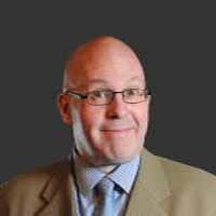
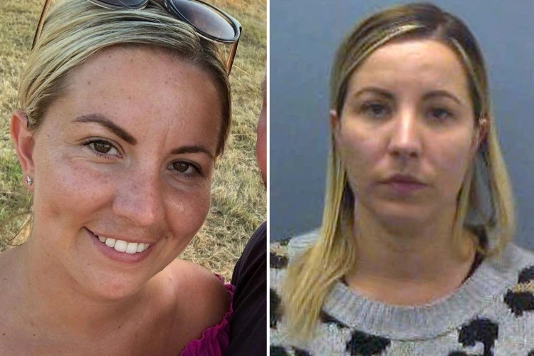
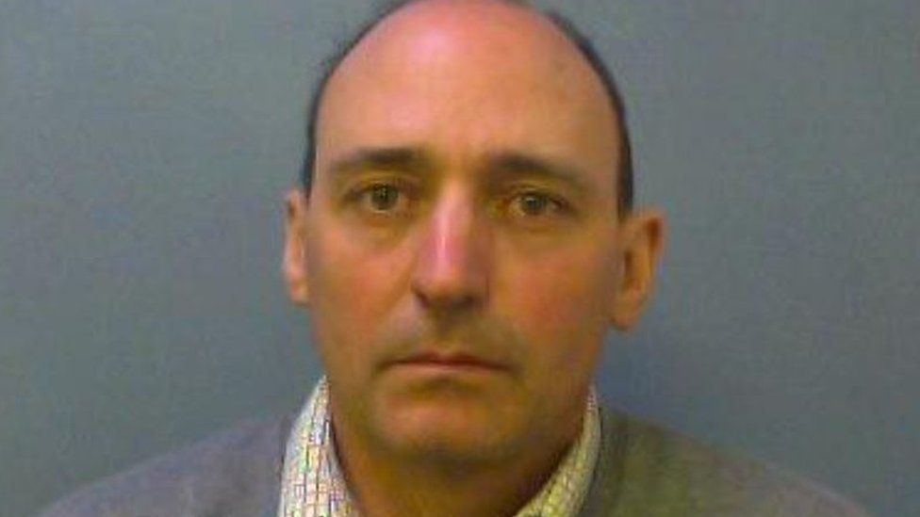
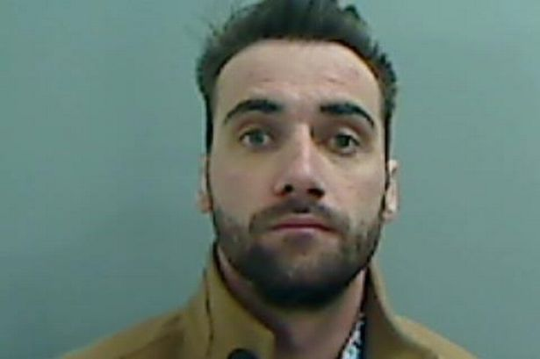
It Did Happen Here……..
Notes:
Top Row Left to Right
Andrew Oldfield. Primary School teacher. Abused 13 year old girl for four years (aged 13-17). Childs mother found Whatsapp messages and reported. Messages and Sexual activity admitted. Lifetime ban from teaching.
Kandice Barber. Teacher had sex with 15 year old student. Jailed for six years.
Melissa Tweedie. Secondary school teacher. Banned from teaching after sexual activity with 18 year old student following the leavers prom.
Damian Ryan. Banned from teaching for life for broadcasting a youtube channel against Muslims, Gay and Transgender people.
Bottom Row Left to Right
David Stus. Filmed a child’s (16) bottom without her consent whilst bending over at school. Banned from teaching.
Thomas Heayel. Primary school teacher. Banned indefinitely. Took and sold pictures of himself online. Although did not directly involve children, children at the school could have seen the pictures online and it has potential to damage the reputation of teaching.
Matthew Mowbray. Going into bedrooms at night at a boarding school. Taking images and sexual touching. Jailed for five years and banned from teaching for life.
Jonathan Clayton. 13 charges of sexual assault on children under the age of 13. Jailed for 8 ½ years, sex offenders register and banned from teaching.

Slide 29
Concerns about a Member of Staff
If there are any concerns regarding a member of staff including supply staff, this should be referred to Headteacher.
Where concerns are about Headteacher report to the Deputy CEO.
Concerns about the Deputy CEO are to be reported to the Chair of Trust.
If staff have a concern about safeguarding practice or procedures they should raise these with SLT - Whistleblowing Policy

Slide 30
Low Level Concerns
A low-level concern is any concern that an adult has acted in a way that:
is inconsistent with the staff code of conduct, including inappropriate conduct outside of work
doesn’t meet the threshold of harm or is not considered serious enough for the school to refer to the local authority.
Examples of such behaviour could include:
being over friendly with children
having favourites
adults taking photographs of children on their mobile phone
engaging with a child on a one-to-one basis in a secluded area or behind a closed door
using inappropriate sexualised, intimidating or offensive language.

Slide 31
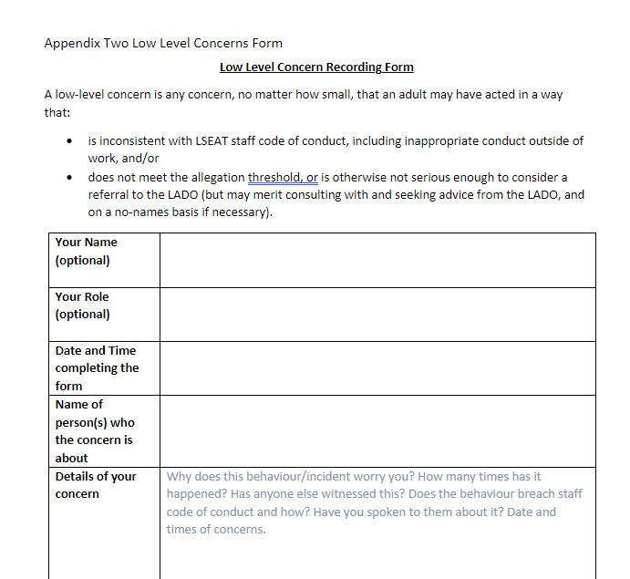
Low Level Concerns
Report your low level concerns to Head Teacher/ Head of School
You can self-refer (for example I just had this ‘situation’ happen and I want to share.
Complete the Low Level Concern form.
Forms will be kept on file for duration of employment
Will not be shared in references unless threshold of harm has been met

Slide 32
Things to Remember……
Never promise any student that you will not tell anyone
Never be in a room alone with a student unless door is open or plenty of windows in room
Be caring but at the same time be aware of how things could be misconstrued
Never ask leading questions if a child discloses to you, just listen, 4Ws and summarise what they have said.
If a child is telling you something, either ask if it is ok for you to write notes at the time or write it up immediately after.
Always hand write your notes which you pass on.
If you suspect anything then always talk to DSL.
Never take a picture of an injury even if asked to by SLT, SC or police
Never view images if a child or parent are reporting SEXTING to you
Face Book, Cameras and Mobile Phone Texting – issues surrounding these, remember Code of Conduct and IT User Agreement
Safeguarding is Everyone’s Responsibility
Always share information – never assume someone else will do it

Slide 33
So just to recap… Safeguarding is everyone's responsibility.
What am I looking for?
ANY of the signs and symptoms of abuse
Any CHANGE in behaviour or appearance
What do I do about it?
Record your observations and concern
REPORT it via CPOMS and if urgent speak to DSL team
Why is it important?
It is EVERYONE’S responsibility to keep our pupils safe and free from harm.

Slide 34
Policies and Documents for all staff to read and implement.....
Safeguarding Policy
E-Safety Policy
Sexual Harassment and Sexual Violence Policy
Prevent Policy
Social Media Policy
Positive Handling Policy
Staff Code of Conduct
Behaviour Policy (school policy)

